Slide 1
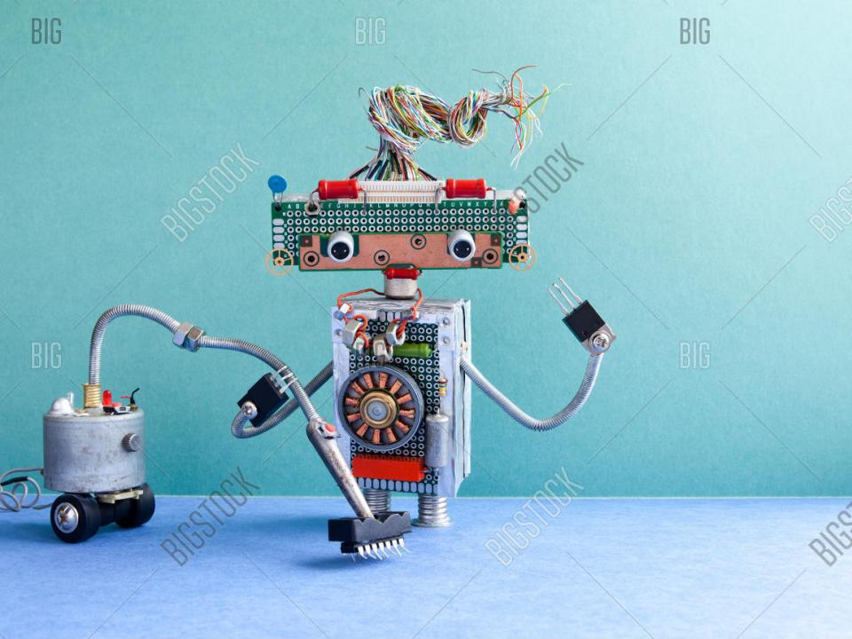
CLEANING ROBOT
CSE 3216
Microcontroller based System Design Lab
Submitted to :
Afsana Ahmed Munia
Assistant Professor, Department of CSE, AUST
Mir Tafseer Nayeem
Assistant Professor, Department of CSE, AUST
Submitted By:
Refat-E-ferdous 16.02.04.015
Mustavi islam khan 16.02.04.022
Ashikur rahman 16.02.04.025
Mayisha farzana 16.02.04.028

Slide 2
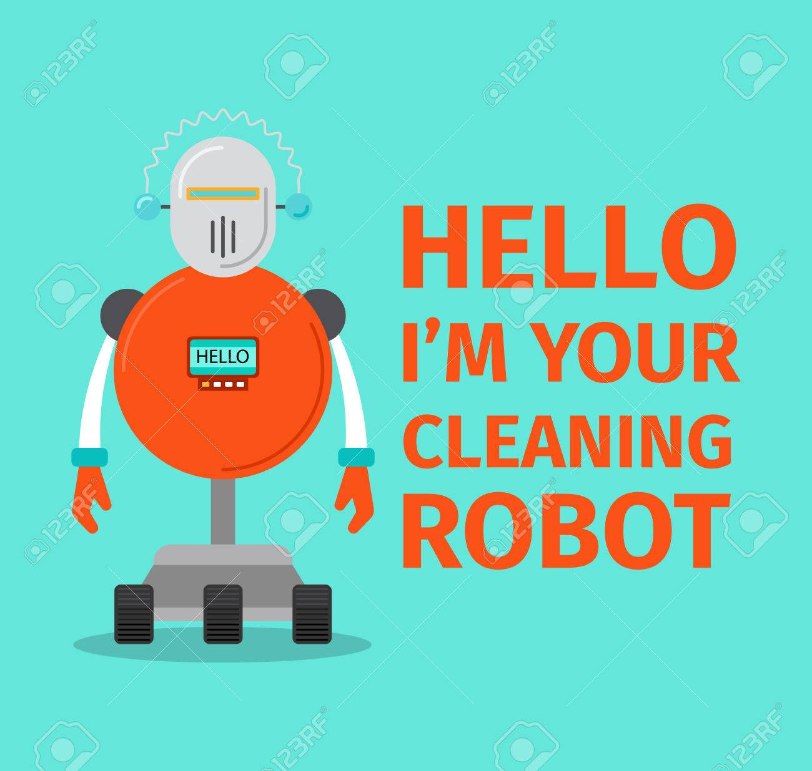
Introduction: We are going to design a system that acts as platform to receive message which indeed are command that are sent to control different appliances and devices that are connected to that platform. The entire control system works on GSM technology that can control the device effectively.
10/10/2019
2
Cleaning Robot

Slide 3
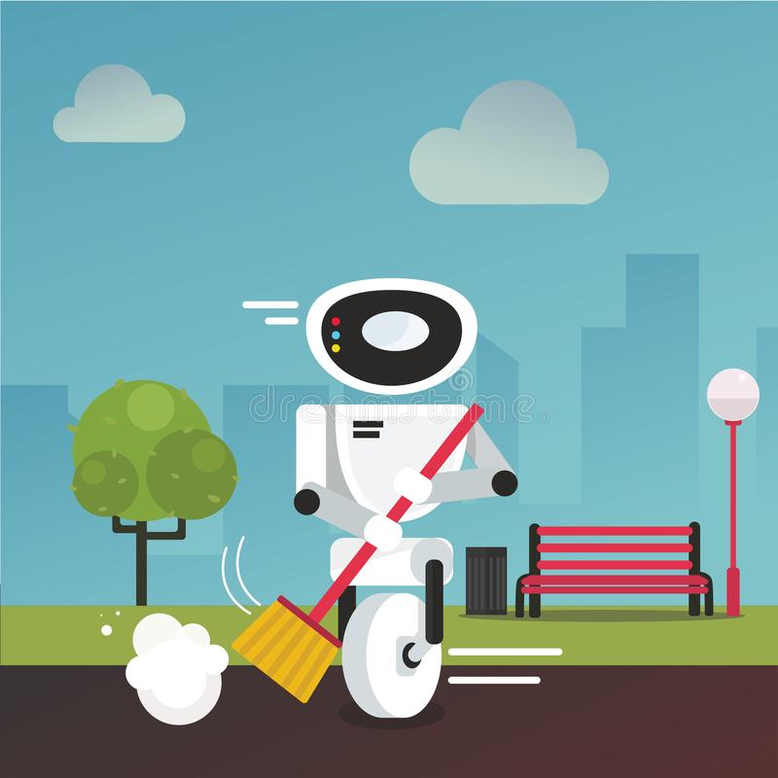
Objective: The aim of our project is to present a GSM based wireless control robot. This robot receives an sms to the sim in the GSM module through an antenna.
10/10/2019
3
Cleaning Robot

Slide 4
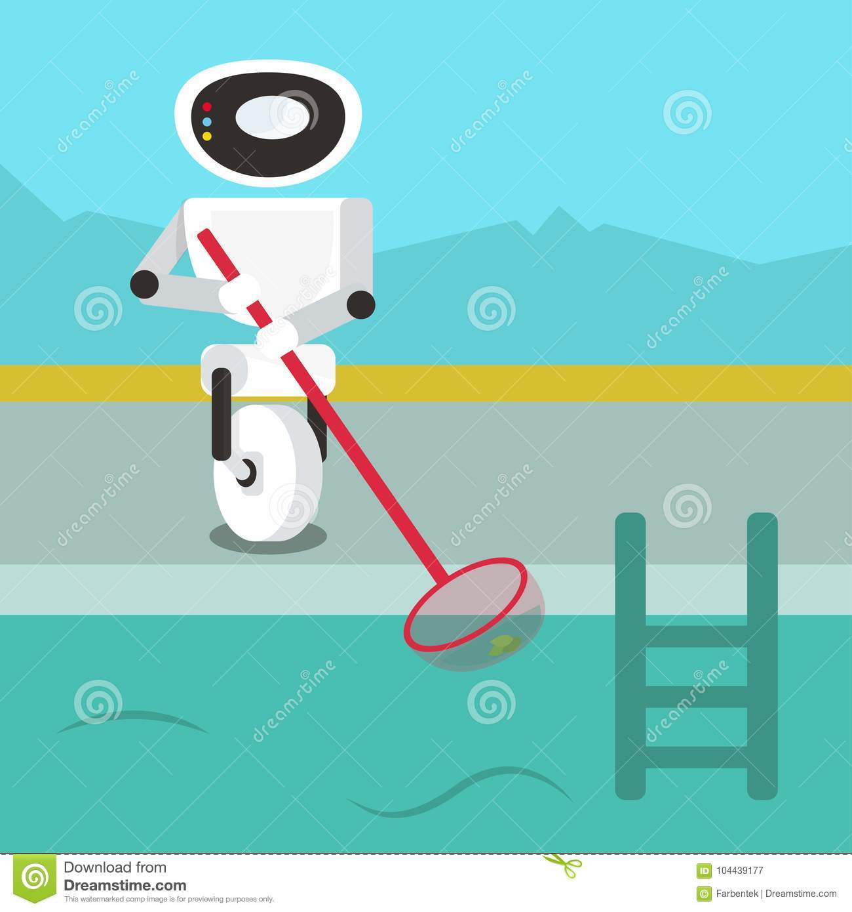
Equipments:
10/10/2019
4
Cleaning Robot

Slide 5
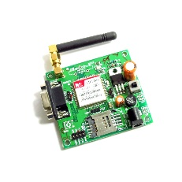
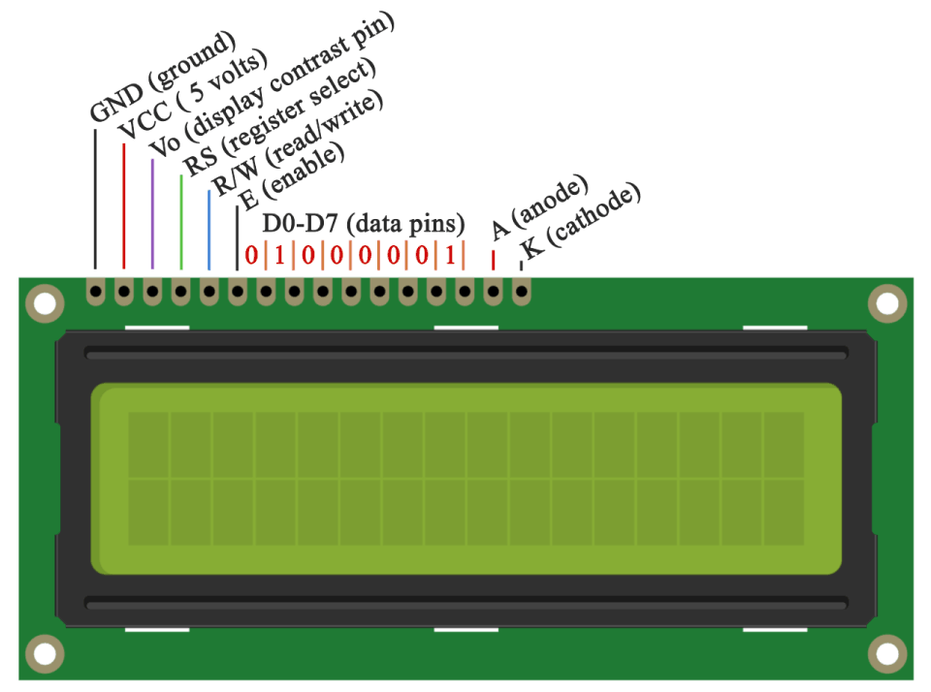
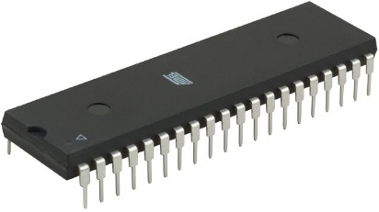
Hardware Components:
GSM Modulo
LCD Display
Microcontroller
10/10/2019
5
Cleaning Robot

Slide 6
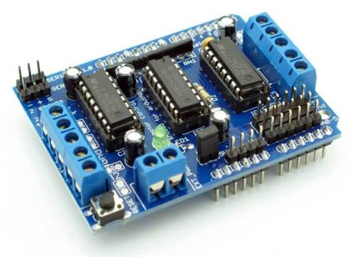
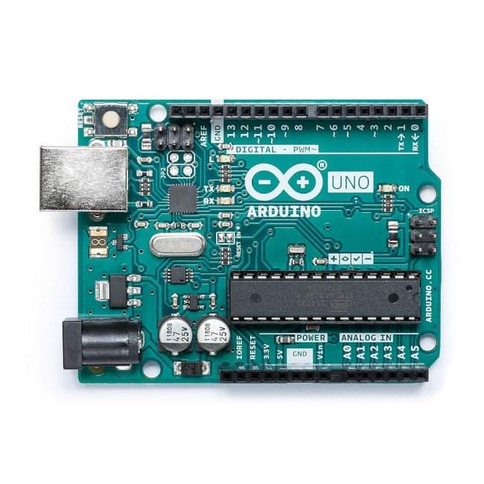
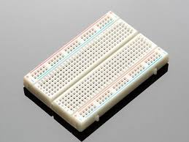
Hardware Components:
Arduino UNO
Motor Driver
Breadboard
10/10/2019
6
Cleaning Robot

Slide 7
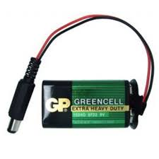
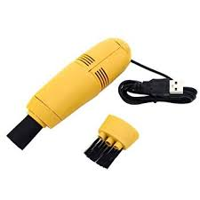
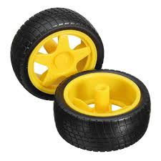
Hardware Components:
Rechargeable Battery
Vacuum Cleaner
Wheels For Motors
10/10/2019
7
Cleaning Robot

Slide 8
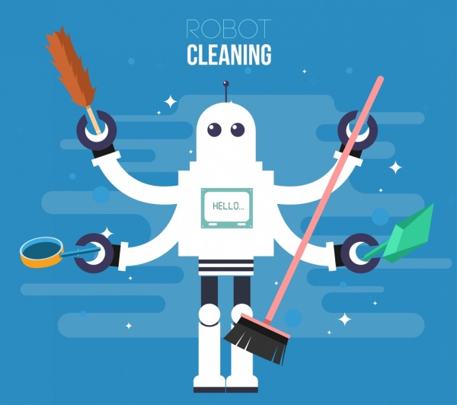
Details:
10/10/2019
8
Cleaning Robot

Slide 9
A GSM modem can also be a standard GSM mobile phone with the appropriate cable and software driver to connect to a serial port or USB port on your computer.
This Modulo will help the robot to get information that what he has to do .
It contains everything needed to support the microcontroller; simply connect it to a computer with a USB cable or power it with a AC-to-DC adapter or battery to get started.
Motor Driver circuits are current amplifiers. They act as a bridge between the controller and the motor in a motor drive. The function of the circuit is to convert the low current signal to a high current signal
GSM MODULO
Microcontroller
Motor Driver
10/10/2019
9
Cleaning Robot

Slide 10
A breadboard is a solderless device for temporary prototype with electronics and test circuit designs. Most electronic components in electronic circuits can be interconnected by inserting their leads or terminals into the holes and then making connections through wires where appropriate.
Arduino Uno is a microcontroller board based on 8-bit ATmega328P microcontroller. Along with ATmega328P, it consists of other components such as crystal oscillator, serial communication, voltage regulator, etc. to support the microcontroller.
a household appliance for cleaning floors, carpets, upholstery, etc. by suction. It is generally electrically driven. ... Specialized shop vacuums can be used to suck up both dust and liquids.
Breadboard
Arduino IDE
Vacuum Cleaner
10
Cleaning Robot

Slide 11
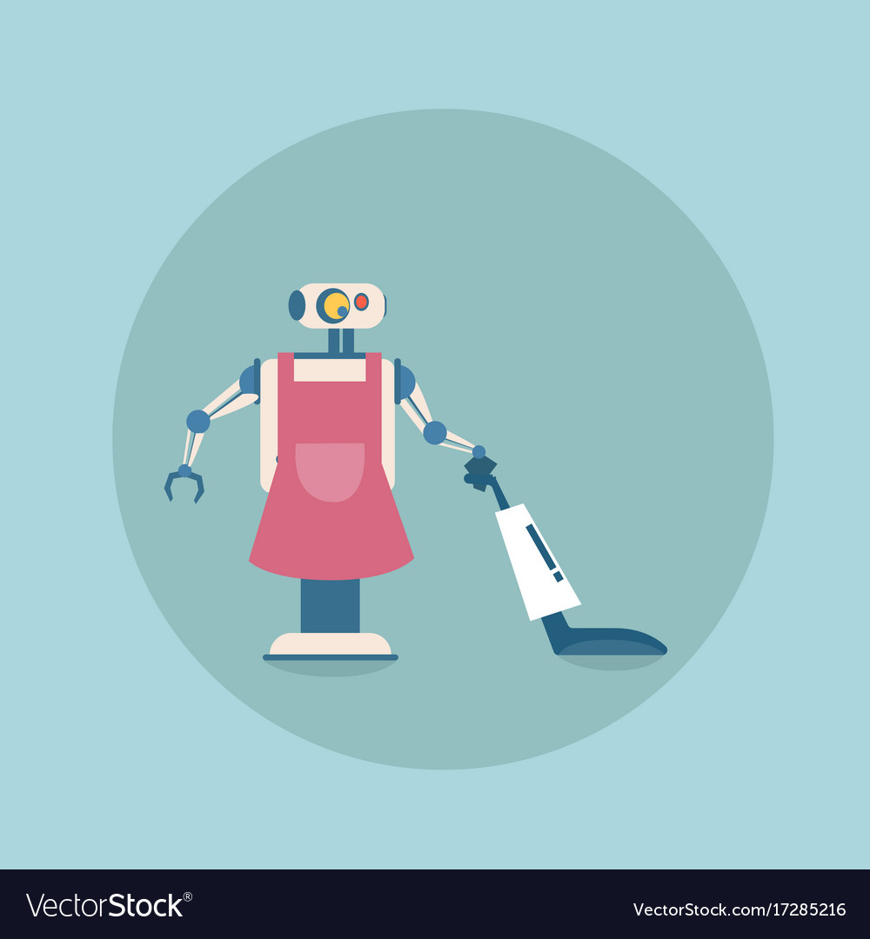
Proteus Implementation:
10/10/2019
11
Cleaning Robot

Slide 12
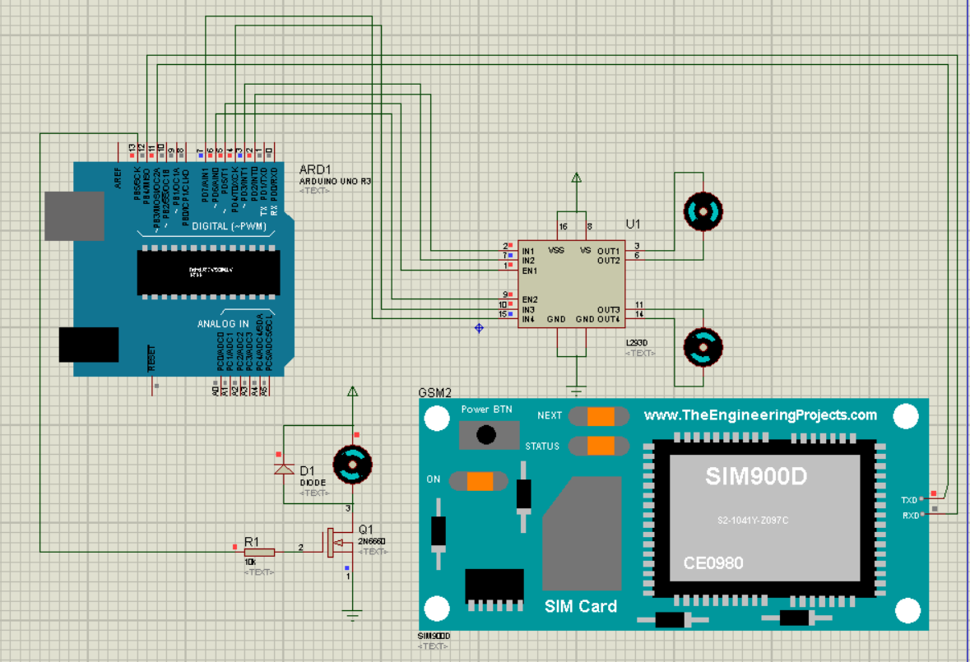
10/10/2019
Cleaning Robot
12

Slide 13

Society Purpose:
No need for manual operation
No Time, No Problem
Can Clean When We Aren’t Home
Low Maintenance
​
10/10/2019
13
Cleaning Robot

Slide 14
Society Purpose:
Robot vacuum cleaners can suck up the dust for us
People can control the robot from anywhere
It will add a recycle value too
​
10/10/2019
14
Cleaning Robot

Slide 15
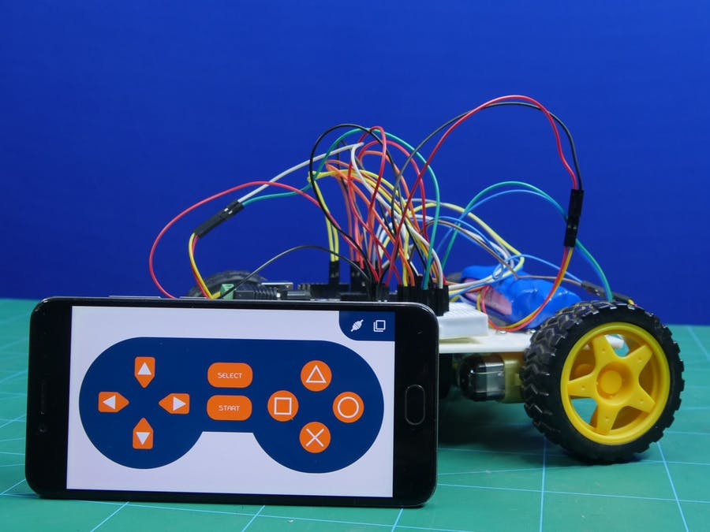
An Image of Similar Project
.”
10/10/2019
15
Cleaning Robot

Slide 16

BUDGET
10/10/2019
16
Cleaning Robot

Slide 17

BUDGET
Total cost of the parts: 6440 Taka (approximately)
10/10/2019
17
Cleaning Robot

Slide 18
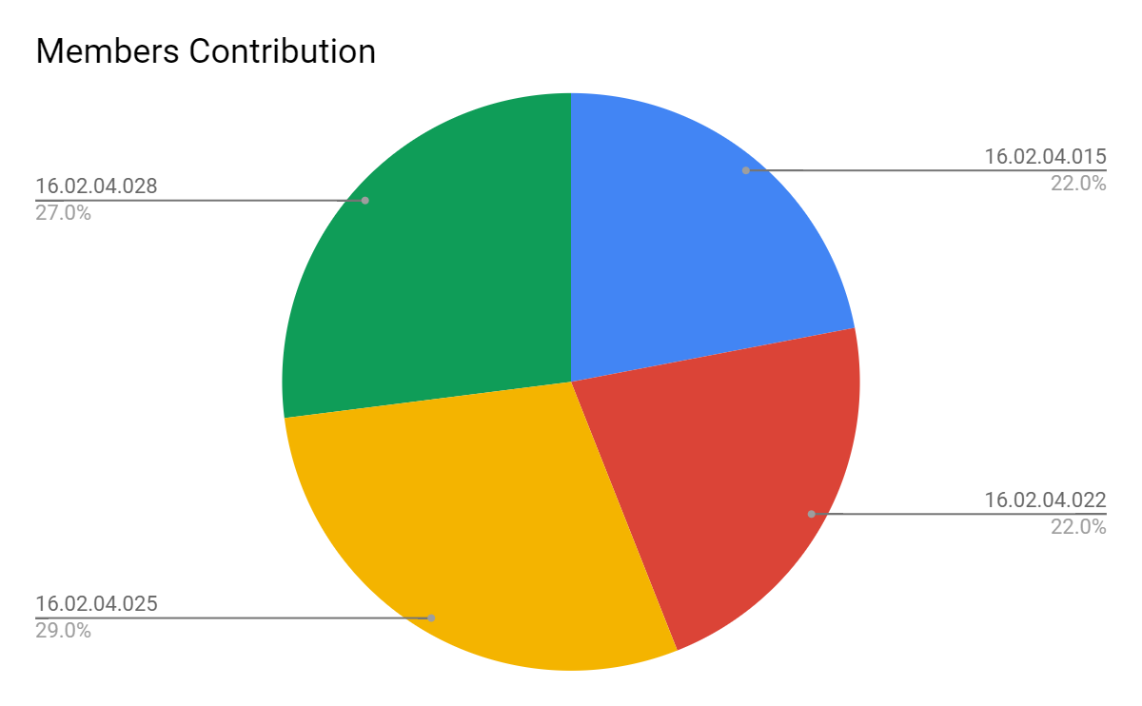
Contribution

Slide 19
Conclusion
“Cleaning robot” efficient and to minimize the physical labor of all the home cleaners. It not only saves time but at the same time the energy of the users as they can operate this robot with their mobile device efficiently. Overall this robot will be a benefit to the society and ensure the quality of cleaning a home.
19
Cleaning Robot

Slide 20
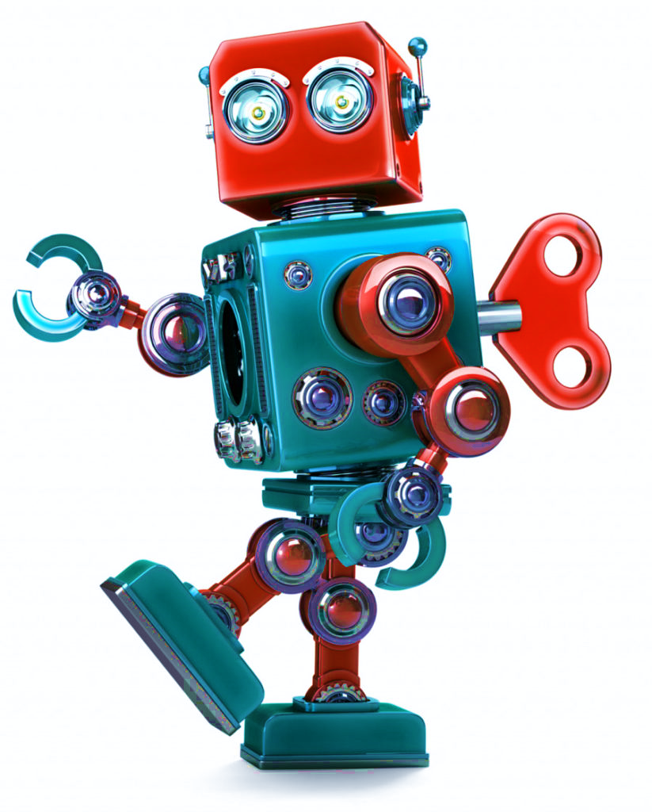
Any Questions ?
10/10/2019
20
Cleaning Robot

Slide 21

YOU
Does anyone have any questions?
21

